Slide 1
Writing with AI Class Project
Interim Analysis of Interviews
Presentation to UWB
Learning & Teaching Collaborative
& Writing Council
CSS 478 Class Project
May 20, 2025
Notes:
Research question / Motivation for this study
Related Research
Our methodology
Interviewers reflections on the interviews: what went well, what didn't go well, what we might do differently next time
Range of prior experience with AI outside of school
Range of prior experience with AI in prior coursework (activities, tools, topics, courses)
Experience with specific AI technologies (outside school, in prior course work, for Dr. Tony's assignments - account for all mentions of specific tech and what nuances we can glean about differences in use between them or patterns of usage across them)
Range of attitudes about AI use in prior coursework (helpful / not helpful)
Confidence as a writer prior to Dr. Tony's assignment
Prior experience using AI for writing
First Impresssions of [actual assignment name or our name for the assignment]
What was challenging about the assignment
How does the assignment compare? [for those with prior experience] different/the same
How does the assignment compare? [for those speculating]
Anything you would change about the assignment?
Has the assignment helped you improve as a writer? [helpful, not helpful, not sure]
Did the assigment change your ideas about AI?
As a UWB student, in terms of teaching and learning with AI, is there anything that you would like them to know or be thinking about ?
Anything else?
Interviewers' reflections directly after the interviews: Surprises
Open Discussion
Possible Next Steps

Slide 2
INTRODUCTION
Byron
Exploring the Student Experience on Writing with AI
Background
Findings
Our reflections
Discussion
Next steps
Notes:
Research question / Motivation for this study
Related Research
Our methodology
Interviewers reflections on the interviews: what went well, what didn't go well, what we might do differently next time
Range of prior experience with AI outside of school
Range of prior experience with AI in prior coursework (activities, tools, topics, courses)
Experience with specific AI technologies (outside school, in prior course work, for Dr. Tony's assignments - account for all mentions of specific tech and what nuances we can glean about differences in use between them or patterns of usage across them)
Range of attitudes about AI use in prior coursework (helpful / not helpful)
Confidence as a writer prior to Dr. Tony's assignment
Prior experience using AI for writing
First Impresssions of [actual assignment name or our name for the assignment]
What was challenging about the assignment
How does the assignment compare? [for those with prior experience] different/the same
How does the assignment compare? [for those speculating]
Anything you would change about the assignment?
Has the assignment helped you improve as a writer? [helpful, not helpful, not sure]
Did the assigment change your ideas about AI?
As a UWB student, in terms of teaching and learning with AI, is there anything that you would like them to know or be thinking about ?
Anything else?
Interviewers' reflections directly after the interviews: Surprises
Open Discussion
Possible Next Steps

Slide 3
BACKGROUND
Motivation/Research Q’s
Aleeza, Areej, and Zeba
Motivation
This project is part of a five-week collaboration involving students in CSS 478: Usability and User-Centered Design, the UW Bothell Writing Council, and the Office of Faculty Success.
The purpose is to understand the student experience of a writing assignment that incorporates AI as designed by Dr. Tony. Dr. Tony’s assignment invites students to use generative AI as a “co-author” at multiple stages of the writing process, such as brainstorming, drafting, and revising. This study aims to explore the impact of AI in education to better the UW Bothell writing boards.
Research Questions
How students move through Dr. Smith’s assignments: their response and opportunities for improvement
A snapshot analysis of student experiences with AI in their lives and at school
A snapshot analysis of student perspectives about AI the highs, lows, hopes, and concerns
What resources can support students who want to try writing with AI while still improving as writers
Notes:
Research question / Motivation for this study
Related Research
Our methodology
Interviewers reflections on the interviews: what went well, what didn't go well, what we might do differently next time
Range of prior experience with AI outside of school
Range of prior experience with AI in prior coursework (activities, tools, topics, courses)
Experience with specific AI technologies (outside school, in prior course work, for Dr. Tony's assignments - account for all mentions of specific tech and what nuances we can glean about differences in use between them or patterns of usage across them)
Range of attitudes about AI use in prior coursework (helpful / not helpful)
Confidence as a writer prior to Dr. Tony's assignment
Prior experience using AI for writing
First Impresssions of [actual assignment name or our name for the assignment]
What was challenging about the assignment
How does the assignment compare? [for those with prior experience] different/the same
How does the assignment compare? [for those speculating]
Anything you would change about the assignment?
Has the assignment helped you improve as a writer? [helpful, not helpful, not sure]
Did the assigment change your ideas about AI?
As a UWB student, in terms of teaching and learning with AI, is there anything that you would like them to know or be thinking about ?
Anything else?
Interviewers' reflections directly after the interviews: Surprises
Open Discussion
Possible Next Steps

Slide 4
BACKGROUND
Methodology
Transcription All interviews had transcripts that were organized by interviewers and uploaded into a google drive for thematic analysis.
Thematic Analysis In small groups, we analyzed specific themes in depth, identifying key patterns and insights.
Memos Each student wrote a part of the memo linking themes to the research questions.
Final Synthesis As a full class, we reviewed all findings, refined the thematic categories, and selected representative quotes to highlight in our final deliverables.
Aleeza, Areej, and Zeba
Initial Meeting (Early April) To better understand the project goals, we met with Dr. Tony Smith (Associate Professor, UWB School of Educational Studies) and Kim Swensen (Instructional Coach, UW Bothell). As a class we discussed about how students use AI in writing.
Interview Protocol The full class brainstormed interview questions; Dr. Dailey refined them into a semi-structured guide.
Interviews (Apr 22–May 6) Conducted 13 interviews (30 mins) solo or in pairs; conducted either in person or on Zoom; all were recorded with consent.
Notes:
Research question / Motivation for this study
Related Research
Our methodology
Interviewers reflections on the interviews: what went well, what didn't go well, what we might do differently next time
Range of prior experience with AI outside of school
Range of prior experience with AI in prior coursework (activities, tools, topics, courses)
Experience with specific AI technologies (outside school, in prior course work, for Dr. Tony's assignments - account for all mentions of specific tech and what nuances we can glean about differences in use between them or patterns of usage across them)
Range of attitudes about AI use in prior coursework (helpful / not helpful)
Confidence as a writer prior to Dr. Tony's assignment
Prior experience using AI for writing
First Impresssions of [actual assignment name or our name for the assignment]
What was challenging about the assignment
How does the assignment compare? [for those with prior experience] different/the same
How does the assignment compare? [for those speculating]
Anything you would change about the assignment?
Has the assignment helped you improve as a writer? [helpful, not helpful, not sure]
Did the assigment change your ideas about AI?
As a UWB student, in terms of teaching and learning with AI, is there anything that you would like them to know or be thinking about ?
Anything else?
Interviewers' reflections directly after the interviews: Surprises
Open Discussion
Possible Next Steps

Slide 5
BACKGROUND
Interviewer Reflections
Aleeza, Areej, and Zeba
What Went Well
14 interviewers mentioned that protocol questions supported natural conversation & helped interviewees open up
Expressed that assigning roles made process more organized
1 person asking questions & another taking notes with commentary
What Didn’t go Well
6 interviewers said their interviews ran short because of lacking open-ended or follow-up questions
5 interviewers highlighted that questions sometimes felt unnatural when read word-for word, making flow awkward
4 interviewers stated that strictly following protocol didn’t allow in-depth engagement with interviewees
What to do Differently in the Future
Having more follow-up questions prepared
Rephrasing script to be more conversational (especially the questions)
Semi-scripted structure with unscripted conversation to give more natural approach, especially for adapting
Notes:
Research question / Motivation for this study
Related Research
Our methodology
Interviewers reflections on the interviews: what went well, what didn't go well, what we might do differently next time
Range of prior experience with AI outside of school
Range of prior experience with AI in prior coursework (activities, tools, topics, courses)
Experience with specific AI technologies (outside school, in prior course work, for Dr. Tony's assignments - account for all mentions of specific tech and what nuances we can glean about differences in use between them or patterns of usage across them)
Range of attitudes about AI use in prior coursework (helpful / not helpful)
Confidence as a writer prior to Dr. Tony's assignment
Prior experience using AI for writing
First Impresssions of [actual assignment name or our name for the assignment]
What was challenging about the assignment
How does the assignment compare? [for those with prior experience] different/the same
How does the assignment compare? [for those speculating]
Anything you would change about the assignment?
Has the assignment helped you improve as a writer? [helpful, not helpful, not sure]
Did the assigment change your ideas about AI?
As a UWB student, in terms of teaching and learning with AI, is there anything that you would like them to know or be thinking about ?
Anything else?
Interviewers' reflections directly after the interviews: Surprises
Open Discussion
Possible Next Steps

Slide 6
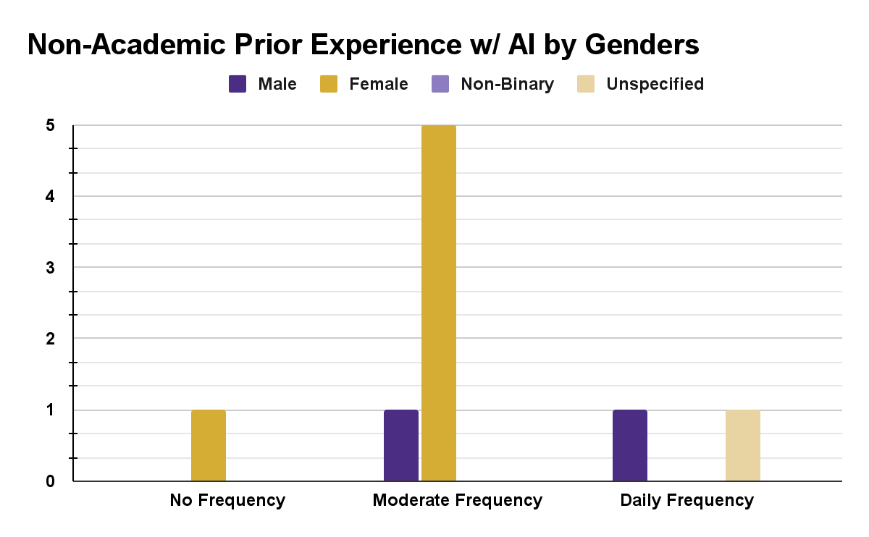
FINDINGS
Billy Kim
Range of prior experience with AI outside of school
Ranges from no prior experience to daily exposure
Moderate: All use cases between no experience and daily experience
Outliers include 1 interviewee with no prior experience explicitly for non-academic use
Notes:
Research question / Motivation for this study
Related Research
Our methodology
Interviewers reflections on the interviews: what went well, what didn't go well, what we might do differently next time
Range of prior experience with AI outside of school
Range of prior experience with AI in prior coursework (activities, tools, topics, courses)
Experience with specific AI technologies (outside school, in prior course work, for Dr. Tony's assignments - account for all mentions of specific tech and what nuances we can glean about differences in use between them or patterns of usage across them)
Range of attitudes about AI use in prior coursework (helpful / not helpful)
Confidence as a writer prior to Dr. Tony's assignment
Prior experience using AI for writing
First Impresssions of [actual assignment name or our name for the assignment]
What was challenging about the assignment
How does the assignment compare? [for those with prior experience] different/the same
How does the assignment compare? [for those speculating]
Anything you would change about the assignment?
Has the assignment helped you improve as a writer? [helpful, not helpful, not sure]
Did the assigment change your ideas about AI?
As a UWB student, in terms of teaching and learning with AI, is there anything that you would like them to know or be thinking about ?
Anything else?
Interviewers' reflections directly after the interviews: Surprises
Open Discussion
Possible Next Steps

Slide 7
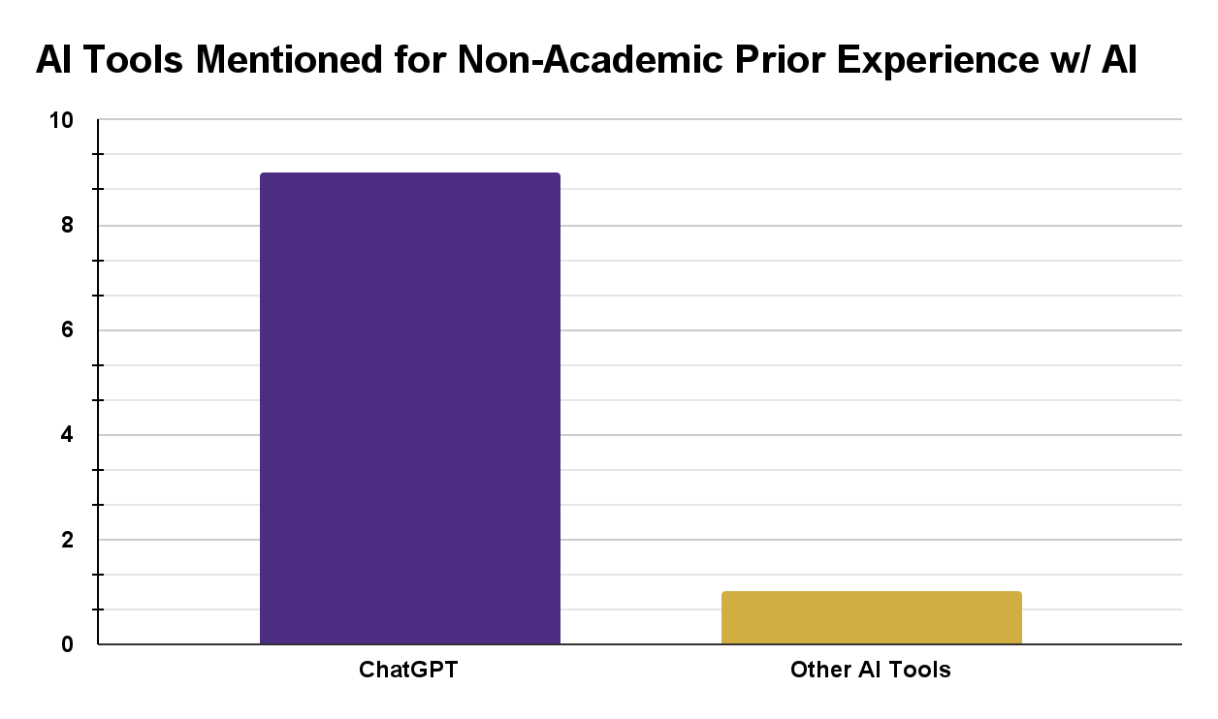
FINDINGS
Billy Kim
AI tools for prior experience with AI outside of school
Any mention of a specific AI tool explicitly for non-academic prior experience included ChatGPT
Outliers include 1 interviewee that named Grammarly and NotebookLM
Notes:
Research question / Motivation for this study
Related Research
Our methodology
Interviewers reflections on the interviews: what went well, what didn't go well, what we might do differently next time
Range of prior experience with AI outside of school
Range of prior experience with AI in prior coursework (activities, tools, topics, courses)
Experience with specific AI technologies (outside school, in prior course work, for Dr. Tony's assignments - account for all mentions of specific tech and what nuances we can glean about differences in use between them or patterns of usage across them)
Range of attitudes about AI use in prior coursework (helpful / not helpful)
Confidence as a writer prior to Dr. Tony's assignment
Prior experience using AI for writing
First Impresssions of [actual assignment name or our name for the assignment]
What was challenging about the assignment
How does the assignment compare? [for those with prior experience] different/the same
How does the assignment compare? [for those speculating]
Anything you would change about the assignment?
Has the assignment helped you improve as a writer? [helpful, not helpful, not sure]
Did the assigment change your ideas about AI?
As a UWB student, in terms of teaching and learning with AI, is there anything that you would like them to know or be thinking about ?
Anything else?
Interviewers' reflections directly after the interviews: Surprises
Open Discussion
Possible Next Steps

Slide 8
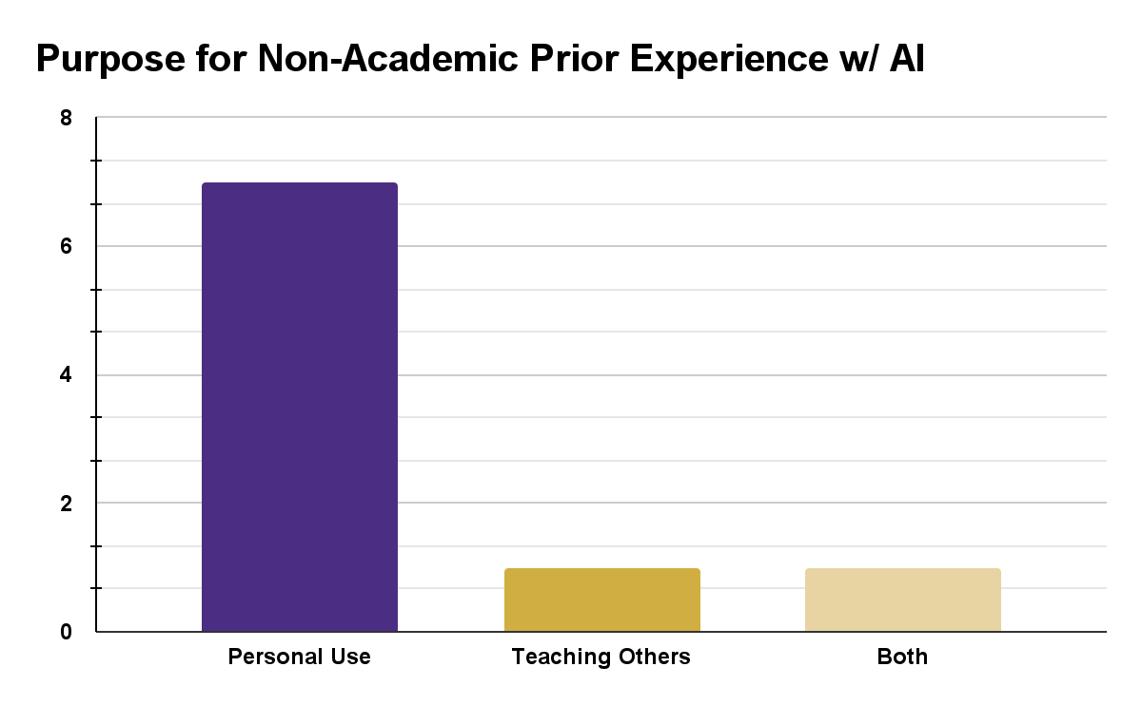
FINDINGS
Billy Kim
Purpose for prior experience with AI outside of school
AI was utilized predominantly for personal use
Personal Use: Generating recipes, trip planning, writing assistant, search engine alternative
Outliers include 2 interviewees that taught others how to use AI
Notes:
Research question / Motivation for this study
Related Research
Our methodology
Interviewers reflections on the interviews: what went well, what didn't go well, what we might do differently next time
Range of prior experience with AI outside of school
Range of prior experience with AI in prior coursework (activities, tools, topics, courses)
Experience with specific AI technologies (outside school, in prior course work, for Dr. Tony's assignments - account for all mentions of specific tech and what nuances we can glean about differences in use between them or patterns of usage across them)
Range of attitudes about AI use in prior coursework (helpful / not helpful)
Confidence as a writer prior to Dr. Tony's assignment
Prior experience using AI for writing
First Impresssions of [actual assignment name or our name for the assignment]
What was challenging about the assignment
How does the assignment compare? [for those with prior experience] different/the same
How does the assignment compare? [for those speculating]
Anything you would change about the assignment?
Has the assignment helped you improve as a writer? [helpful, not helpful, not sure]
Did the assigment change your ideas about AI?
As a UWB student, in terms of teaching and learning with AI, is there anything that you would like them to know or be thinking about ?
Anything else?
Interviewers' reflections directly after the interviews: Surprises
Open Discussion
Possible Next Steps

Slide 9
FINDINGS
Minh Pham and Brian Nguyen
Range of prior experience with AI in prior coursework (activities, tools, topics, courses)
8 interviewees used it for a prior class, 3 didn’t
3 used it for an English/Writing course, 2 used it for a CS course, 2 used it for a Math course
Variety of use cases: tutoring, summarizing, starting/editing a draft
Notes:
Research question / Motivation for this study
Related Research
Our methodology
Interviewers reflections on the interviews: what went well, what didn't go well, what we might do differently next time
Range of prior experience with AI outside of school
Range of prior experience with AI in prior coursework (activities, tools, topics, courses)
Experience with specific AI technologies (outside school, in prior course work, for Dr. Tony's assignments - account for all mentions of specific tech and what nuances we can glean about differences in use between them or patterns of usage across them)
Range of attitudes about AI use in prior coursework (helpful / not helpful)
Confidence as a writer prior to Dr. Tony's assignment
Prior experience using AI for writing
First Impresssions of [actual assignment name or our name for the assignment]
What was challenging about the assignment
How does the assignment compare? [for those with prior experience] different/the same
How does the assignment compare? [for those speculating]
Anything you would change about the assignment?
Has the assignment helped you improve as a writer? [helpful, not helpful, not sure]
Did the assigment change your ideas about AI?
As a UWB student, in terms of teaching and learning with AI, is there anything that you would like them to know or be thinking about ?
Anything else?
Interviewers' reflections directly after the interviews: Surprises
Open Discussion
Possible Next Steps

Slide 10
FINDINGS
Meharvan Singh, Harshal Sarangdhar
Experience with specific AI technologies (in and out of academic settings, in Dr. Tony’s class, etc.
All students used ChatGPT for Dr. Tony’s assignment as well as for other classes, daily tasks, and personal/cultural contexts
6/12 students used Grammarly for grammar and sentence cleanup but mentioned that they didn’t think it was a “real AI tool”
2/12 students said they used MSFT Copilot for prior writing classes but NOT for Dr. Tony’s class
1/12 used Claude for code generation or creating tests for code (also not for Dr. Tony’s class)
Meta AI, Grok, NotebookLM, Perplexity, and Deepseek weren’t used at all
Notes:
Research question / Motivation for this study
Related Research
Our methodology
Interviewers reflections on the interviews: what went well, what didn't go well, what we might do differently next time
Range of prior experience with AI outside of school
Range of prior experience with AI in prior coursework (activities, tools, topics, courses)
Experience with specific AI technologies (outside school, in prior course work, for Dr. Tony's assignments - account for all mentions of specific tech and what nuances we can glean about differences in use between them or patterns of usage across them)
Range of attitudes about AI use in prior coursework (helpful / not helpful)
Confidence as a writer prior to Dr. Tony's assignment
Prior experience using AI for writing
First Impresssions of [actual assignment name or our name for the assignment]
What was challenging about the assignment
How does the assignment compare? [for those with prior experience] different/the same
How does the assignment compare? [for those speculating]
Anything you would change about the assignment?
Has the assignment helped you improve as a writer? [helpful, not helpful, not sure]
Did the assigment change your ideas about AI?
As a UWB student, in terms of teaching and learning with AI, is there anything that you would like them to know or be thinking about ?
Anything else?
Interviewers' reflections directly after the interviews: Surprises
Open Discussion
Possible Next Steps

Slide 11
FINDINGS
John Aylward
Range of attitudes about AI use in prior coursework (helpful / not helpful)
6 out of 10 (this 10 comes from the students that had applicable answers to this question) students found AI useful for learning in prior coursework. This shows that most students are already familiar with AI and may mean that students could be open to its inclusion in coursework.
ES-3 said that AI " would help us better understand the content and forced us to use like critical thinking and our previous knowledge on the content to correct the AI and make sure everything was like right"
2 out of 10 students found that AI didn't help them learn.
ES-1 said that "There was another one that I used to transcribe an interview, … but I don't think that it helped me learn anything,"
4 out of the 6 that found AI useful said that they used AI to tutor them about topics they found difficult.
ES-9 said that in regards to programming homework they "highlight [the problem] and [they ask the AI] what is this specifically doing at each point like each part of this, and it explains to me that well, this is for this, and this is for this.
Notes:
Research question / Motivation for this study
Related Research
Our methodology
Interviewers reflections on the interviews: what went well, what didn't go well, what we might do differently next time
Range of prior experience with AI outside of school
Range of prior experience with AI in prior coursework (activities, tools, topics, courses)
Experience with specific AI technologies (outside school, in prior course work, for Dr. Tony's assignments - account for all mentions of specific tech and what nuances we can glean about differences in use between them or patterns of usage across them)
Range of attitudes about AI use in prior coursework (helpful / not helpful)
Confidence as a writer prior to Dr. Tony's assignment
Prior experience using AI for writing
First Impresssions of [actual assignment name or our name for the assignment]
What was challenging about the assignment
How does the assignment compare? [for those with prior experience] different/the same
How does the assignment compare? [for those speculating]
Anything you would change about the assignment?
Has the assignment helped you improve as a writer? [helpful, not helpful, not sure]
Did the assigment change your ideas about AI?
As a UWB student, in terms of teaching and learning with AI, is there anything that you would like them to know or be thinking about ?
Anything else?
Interviewers' reflections directly after the interviews: Surprises
Open Discussion
Possible Next Steps

Slide 12
FINDINGS
Amrit Kaur, Marcella Pham, Felicia Yeh
“No, I personally really enjoy the writing process. Yes, and I am very prideful about my work if that's the right word to use, and so I do just kind of old fashioned, like, Hey, here's my paper. Can you find some grammar issues with it? And then we talk through it. So in general, I do not use AI for writing.” - ES-01
How confident were students as writers before using AI?
8 out of 11 students felt confident as writers.
3 were less confident and relied more on AI.
Key insights:
Confident writers often preferred using their own voice over AI assistance.
Less confident writers used AI mainly for grammar help and idea generation.
Data: (11 of 12 responses received)
“A lot of the writing I've done has always been on my own. I never really saw AI as a tool for drafting or designing, and part of that is because its reliability is very questionable." - ES-13
Notes:
Research question / Motivation for this study
Related Research
Our methodology
Interviewers reflections on the interviews: what went well, what didn't go well, what we might do differently next time
Range of prior experience with AI outside of school
Range of prior experience with AI in prior coursework (activities, tools, topics, courses)
Experience with specific AI technologies (outside school, in prior course work, for Dr. Tony's assignments - account for all mentions of specific tech and what nuances we can glean about differences in use between them or patterns of usage across them)
Range of attitudes about AI use in prior coursework (helpful / not helpful)
Confidence as a writer prior to Dr. Tony's assignment
Prior experience using AI for writing
First Impresssions of [actual assignment name or our name for the assignment]
What was challenging about the assignment
How does the assignment compare? [for those with prior experience] different/the same
How does the assignment compare? [for those speculating]
Anything you would change about the assignment?
Has the assignment helped you improve as a writer? [helpful, not helpful, not sure]
Did the assigment change your ideas about AI?
As a UWB student, in terms of teaching and learning with AI, is there anything that you would like them to know or be thinking about ?
Anything else?
Interviewers' reflections directly after the interviews: Surprises
Open Discussion
Possible Next Steps

Slide 13
FINDINGS
Amrit Kaur, Marcella Pham, Felicia Yeh
What prior experience did students have with AI for writing?
Yes: 6
No: 4
N/A: 1
Key insight:
6 students used AI as a technical support tool, which was useful for tasks like grammar corrections or idea generations, not for completing all content. They used it to enhance their writing, not to replace their own voices.
“almost every day... I use it to summarize articles, put paragraphs together, grammar checks, literally every like math, physics problems. I use everything pretty much." - ES-07
“I like to do creative writing, and so sometimes I'll have Chat GPT give me like a prompt, if I'm struggling with maybe a type of writing I wanna do.” - ES-03
Notes:
Research question / Motivation for this study
Related Research
Our methodology
Interviewers reflections on the interviews: what went well, what didn't go well, what we might do differently next time
Range of prior experience with AI outside of school
Range of prior experience with AI in prior coursework (activities, tools, topics, courses)
Experience with specific AI technologies (outside school, in prior course work, for Dr. Tony's assignments - account for all mentions of specific tech and what nuances we can glean about differences in use between them or patterns of usage across them)
Range of attitudes about AI use in prior coursework (helpful / not helpful)
Confidence as a writer prior to Dr. Tony's assignment
Prior experience using AI for writing
First Impresssions of [actual assignment name or our name for the assignment]
What was challenging about the assignment
How does the assignment compare? [for those with prior experience] different/the same
How does the assignment compare? [for those speculating]
Anything you would change about the assignment?
Has the assignment helped you improve as a writer? [helpful, not helpful, not sure]
Did the assigment change your ideas about AI?
As a UWB student, in terms of teaching and learning with AI, is there anything that you would like them to know or be thinking about ?
Anything else?
Interviewers' reflections directly after the interviews: Surprises
Open Discussion
Possible Next Steps

Slide 14
FINDINGS
Cole and Vlad
First Impressions of Dr. Tony’s Children's Book Review Assignment
1 student was hesitant “My first impressions were hesitant, because I felt like I could have written a review myself” – ES-01
2 students were intrigued “I just thought it was pretty interesting that, like, I guess, being assigned to use ChatGPT because I've never seen that before in other classes.” – ES-08
2 students were excited “I was definitely really excited because this was my like first ever college assignment where we got to use AI” – ES-03
2 students were shocked “I was kind of shocked that we were allowed to use AI. I wasn't expecting that” – ES-11
2 students had a neutral impression “I Mean, I just kind of took as like any other assignment.” – ES-05
1 student was confused “I think I was, it was a bit confusing because most professors … encourage you not to use AI” – ES-15
Notes:
Research question / Motivation for this study
Related Research
Our methodology
Interviewers reflections on the interviews: what went well, what didn't go well, what we might do differently next time
Range of prior experience with AI outside of school
Range of prior experience with AI in prior coursework (activities, tools, topics, courses)
Experience with specific AI technologies (outside school, in prior course work, for Dr. Tony's assignments - account for all mentions of specific tech and what nuances we can glean about differences in use between them or patterns of usage across them)
Range of attitudes about AI use in prior coursework (helpful / not helpful)
Confidence as a writer prior to Dr. Tony's assignment
Prior experience using AI for writing
First Impresssions of [actual assignment name or our name for the assignment]
What was challenging about the assignment
How does the assignment compare? [for those with prior experience] different/the same
How does the assignment compare? [for those speculating]
Anything you would change about the assignment?
Has the assignment helped you improve as a writer? [helpful, not helpful, not sure]
Did the assigment change your ideas about AI?
As a UWB student, in terms of teaching and learning with AI, is there anything that you would like them to know or be thinking about ?
Anything else?
Interviewers' reflections directly after the interviews: Surprises
Open Discussion
Possible Next Steps

Slide 15
FINDINGS
Fred
Reported Challenges:
2 students reported inaccuracies with AI results, such as fabricating novel events
3 pointed out that after reading the AI’s words, they couldnt get them out of their head or just didnt know what to change, hindering imagination
2 had trouble editing to make it feel natural
2 perceived zero benefits from using AI for the task
2 outliers remained, 1 mentioned zero challenges and talked about external strategic uses, and the other noted the uniqueness
Notes:
Research question / Motivation for this study
Related Research
Our methodology
Interviewers reflections on the interviews: what went well, what didn't go well, what we might do differently next time
Range of prior experience with AI outside of school
Range of prior experience with AI in prior coursework (activities, tools, topics, courses)
Experience with specific AI technologies (outside school, in prior course work, for Dr. Tony's assignments - account for all mentions of specific tech and what nuances we can glean about differences in use between them or patterns of usage across them)
Range of attitudes about AI use in prior coursework (helpful / not helpful)
Confidence as a writer prior to Dr. Tony's assignment
Prior experience using AI for writing
First Impresssions of [actual assignment name or our name for the assignment]
What was challenging about the assignment
How does the assignment compare? [for those with prior experience] different/the same
How does the assignment compare? [for those speculating]
Anything you would change about the assignment?
Has the assignment helped you improve as a writer? [helpful, not helpful, not sure]
Did the assigment change your ideas about AI?
As a UWB student, in terms of teaching and learning with AI, is there anything that you would like them to know or be thinking about ?
Anything else?
Interviewers' reflections directly after the interviews: Surprises
Open Discussion
Possible Next Steps

Slide 16
FINDINGS
Mama Thomas
How does the assignment compare? [for those with prior experience] different/the same
Assignment required deeper engagement than past uses
More emphasis on fact checking and revision
Clear shift from idea generation to content creation
"Honestly, I guess the difference for this one is 'cause, like, sometimes when I use AI, I don't, like, know for sure. But, like, this one, it was like a book I read. I knew everything about it." -ES-11
"In this assignment, we had to like, correct AI."- ES-12
Notes:
Research question / Motivation for this study
Related Research
Our methodology
Interviewers reflections on the interviews: what went well, what didn't go well, what we might do differently next time
Range of prior experience with AI outside of school
Range of prior experience with AI in prior coursework (activities, tools, topics, courses)
Experience with specific AI technologies (outside school, in prior course work, for Dr. Tony's assignments - account for all mentions of specific tech and what nuances we can glean about differences in use between them or patterns of usage across them)
Range of attitudes about AI use in prior coursework (helpful / not helpful)
Confidence as a writer prior to Dr. Tony's assignment
Prior experience using AI for writing
First Impresssions of [actual assignment name or our name for the assignment]
What was challenging about the assignment
How does the assignment compare? [for those with prior experience] different/the same
How does the assignment compare? [for those speculating]
Anything you would change about the assignment?
Has the assignment helped you improve as a writer? [helpful, not helpful, not sure]
Did the assigment change your ideas about AI?
As a UWB student, in terms of teaching and learning with AI, is there anything that you would like them to know or be thinking about ?
Anything else?
Interviewers' reflections directly after the interviews: Surprises
Open Discussion
Possible Next Steps

Slide 17
FINDINGS
Mama Thomas
How does the assignment compare? [for those speculating]
Mostly matched expectations overall
AI output was brief or incomplete sometimes
Some surprises in what AI generated occasionally
"Same: I would ask ChatGPT to put it all together. Different: First time noticing AI can mix things up on accident." -ES-07
"I guess I didn't really expect anything like crazy different... But the answer ChatGPT gave was just one paragraph, and for me it was like 3 paragraphs."- ES-08
Notes:
Research question / Motivation for this study
Related Research
Our methodology
Interviewers reflections on the interviews: what went well, what didn't go well, what we might do differently next time
Range of prior experience with AI outside of school
Range of prior experience with AI in prior coursework (activities, tools, topics, courses)
Experience with specific AI technologies (outside school, in prior course work, for Dr. Tony's assignments - account for all mentions of specific tech and what nuances we can glean about differences in use between them or patterns of usage across them)
Range of attitudes about AI use in prior coursework (helpful / not helpful)
Confidence as a writer prior to Dr. Tony's assignment
Prior experience using AI for writing
First Impresssions of [actual assignment name or our name for the assignment]
What was challenging about the assignment
How does the assignment compare? [for those with prior experience] different/the same
How does the assignment compare? [for those speculating]
Anything you would change about the assignment?
Has the assignment helped you improve as a writer? [helpful, not helpful, not sure]
Did the assigment change your ideas about AI?
As a UWB student, in terms of teaching and learning with AI, is there anything that you would like them to know or be thinking about ?
Anything else?
Interviewers' reflections directly after the interviews: Surprises
Open Discussion
Possible Next Steps

Slide 18
FINDINGS
Yaried Yishak
Anything you would change about the assignment?
No changes (7 students)
Make students describe what prompts were used (2 students)
“I feel like what you prompt it to do is very important because the prompt that you give it shows your understanding of what you're asking it to do, and your understanding of the material that you're trying to get out of it” (ES-03)
Give more room for experimenting with AI in the assignment (2 students)
“I played around with it a little bit on my own, not in the assignment, cause I kinda wanted to see, like, how it would be from, like, someone that, for example, someone that’s like a Republican, or like, what a Republican would’ve viewed the book as, be very different than what I would, the way I see the book” (ES-15)
Write the book review before involving AI (1 student)
“Those thoughts are already in your mind now, and it's difficult to think of other things when that's already in there” (ES-09)

Slide 19
Has the assignment helped you improve as a writer?
Ethan Kolakaluri
Notes:
Research question / Motivation for this study
Related Research
Our methodology
Interviewers reflections on the interviews: what went well, what didn't go well, what we might do differently next time
Range of prior experience with AI outside of school
Range of prior experience with AI in prior coursework (activities, tools, topics, courses)
Experience with specific AI technologies (outside school, in prior course work, for Dr. Tony's assignments - account for all mentions of specific tech and what nuances we can glean about differences in use between them or patterns of usage across them)
Range of attitudes about AI use in prior coursework (helpful / not helpful)
Confidence as a writer prior to Dr. Tony's assignment
Prior experience using AI for writing
First Impresssions of [actual assignment name or our name for the assignment]
What was challenging about the assignment
How does the assignment compare? [for those with prior experience] different/the same
How does the assignment compare? [for those speculating]
Anything you would change about the assignment?
Has the assignment helped you improve as a writer? [helpful, not helpful, not sure]
Did the assigment change your ideas about AI?
As a UWB student, in terms of teaching and learning with AI, is there anything that you would like them to know or be thinking about ?
Anything else?
Interviewers' reflections directly after the interviews: Surprises
Open Discussion
Possible Next Steps

Slide 20

Ethan Kolakaluri
Notes:
Research question / Motivation for this study
Related Research
Our methodology
Interviewers reflections on the interviews: what went well, what didn't go well, what we might do differently next time
Range of prior experience with AI outside of school
Range of prior experience with AI in prior coursework (activities, tools, topics, courses)
Experience with specific AI technologies (outside school, in prior course work, for Dr. Tony's assignments - account for all mentions of specific tech and what nuances we can glean about differences in use between them or patterns of usage across them)
Range of attitudes about AI use in prior coursework (helpful / not helpful)
Confidence as a writer prior to Dr. Tony's assignment
Prior experience using AI for writing
First Impresssions of [actual assignment name or our name for the assignment]
What was challenging about the assignment
How does the assignment compare? [for those with prior experience] different/the same
How does the assignment compare? [for those speculating]
Anything you would change about the assignment?
Has the assignment helped you improve as a writer? [helpful, not helpful, not sure]
Did the assigment change your ideas about AI?
As a UWB student, in terms of teaching and learning with AI, is there anything that you would like them to know or be thinking about ?
Anything else?
Interviewers' reflections directly after the interviews: Surprises
Open Discussion
Possible Next Steps

Slide 21

Ethan Kolakaluri
Notes:
Research question / Motivation for this study
Related Research
Our methodology
Interviewers reflections on the interviews: what went well, what didn't go well, what we might do differently next time
Range of prior experience with AI outside of school
Range of prior experience with AI in prior coursework (activities, tools, topics, courses)
Experience with specific AI technologies (outside school, in prior course work, for Dr. Tony's assignments - account for all mentions of specific tech and what nuances we can glean about differences in use between them or patterns of usage across them)
Range of attitudes about AI use in prior coursework (helpful / not helpful)
Confidence as a writer prior to Dr. Tony's assignment
Prior experience using AI for writing
First Impresssions of [actual assignment name or our name for the assignment]
What was challenging about the assignment
How does the assignment compare? [for those with prior experience] different/the same
How does the assignment compare? [for those speculating]
Anything you would change about the assignment?
Has the assignment helped you improve as a writer? [helpful, not helpful, not sure]
Did the assigment change your ideas about AI?
As a UWB student, in terms of teaching and learning with AI, is there anything that you would like them to know or be thinking about ?
Anything else?
Interviewers' reflections directly after the interviews: Surprises
Open Discussion
Possible Next Steps

Slide 22
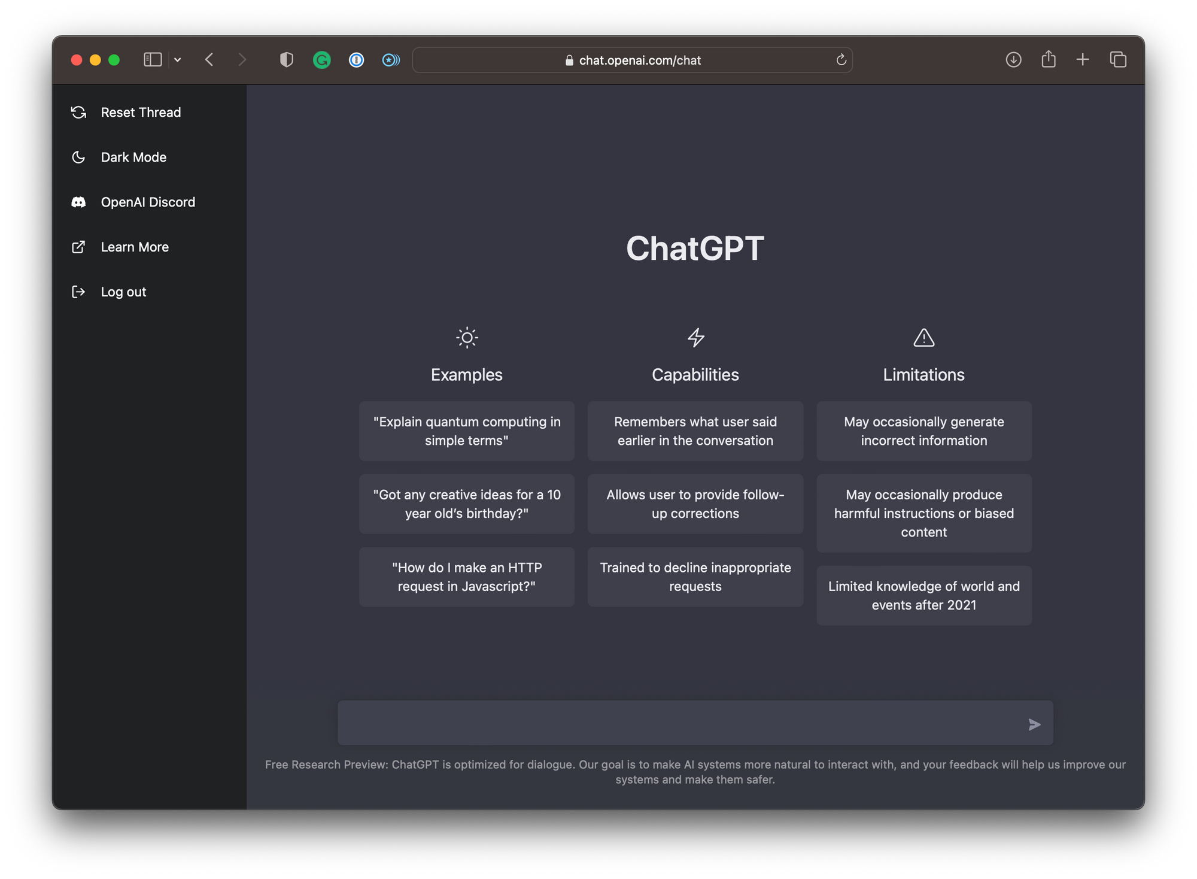
Ethan Kolakaluri
Notes:
Research question / Motivation for this study
Related Research
Our methodology
Interviewers reflections on the interviews: what went well, what didn't go well, what we might do differently next time
Range of prior experience with AI outside of school
Range of prior experience with AI in prior coursework (activities, tools, topics, courses)
Experience with specific AI technologies (outside school, in prior course work, for Dr. Tony's assignments - account for all mentions of specific tech and what nuances we can glean about differences in use between them or patterns of usage across them)
Range of attitudes about AI use in prior coursework (helpful / not helpful)
Confidence as a writer prior to Dr. Tony's assignment
Prior experience using AI for writing
First Impresssions of [actual assignment name or our name for the assignment]
What was challenging about the assignment
How does the assignment compare? [for those with prior experience] different/the same
How does the assignment compare? [for those speculating]
Anything you would change about the assignment?
Has the assignment helped you improve as a writer? [helpful, not helpful, not sure]
Did the assigment change your ideas about AI?
As a UWB student, in terms of teaching and learning with AI, is there anything that you would like them to know or be thinking about ?
Anything else?
Interviewers' reflections directly after the interviews: Surprises
Open Discussion
Possible Next Steps

Slide 23
RESPONDENT ANSWERS
"It made me think, 'What little details am I leaving out?'"
~ ES-03 (Emily Reed) ~
"My writing's still the same. Nothing changed."
~ ES-11 (Hamdi Mohamud) ~
"It made me realize what makes my writing different, but most was done by me."
~ ES-13 (Xavier Tsun) ~
Ethan Kolakaluri
Notes:
Research question / Motivation for this study
Related Research
Our methodology
Interviewers reflections on the interviews: what went well, what didn't go well, what we might do differently next time
Range of prior experience with AI outside of school
Range of prior experience with AI in prior coursework (activities, tools, topics, courses)
Experience with specific AI technologies (outside school, in prior course work, for Dr. Tony's assignments - account for all mentions of specific tech and what nuances we can glean about differences in use between them or patterns of usage across them)
Range of attitudes about AI use in prior coursework (helpful / not helpful)
Confidence as a writer prior to Dr. Tony's assignment
Prior experience using AI for writing
First Impresssions of [actual assignment name or our name for the assignment]
What was challenging about the assignment
How does the assignment compare? [for those with prior experience] different/the same
How does the assignment compare? [for those speculating]
Anything you would change about the assignment?
Has the assignment helped you improve as a writer? [helpful, not helpful, not sure]
Did the assigment change your ideas about AI?
As a UWB student, in terms of teaching and learning with AI, is there anything that you would like them to know or be thinking about ?
Anything else?
Interviewers' reflections directly after the interviews: Surprises
Open Discussion
Possible Next Steps

Slide 24
OVERALL KEY FINDINGS
Justin Tran
4 students found AI helpful: noticed missing details & style improvements
3 students didn’t find it useful: confident writers felt no change
2 students were unsure: saw some benefits but mostly their own work
AI helps best as a reflection tool, not a replacement
Notes:
Research question / Motivation for this study
Related Research
Our methodology
Interviewers reflections on the interviews: what went well, what didn't go well, what we might do differently next time
Range of prior experience with AI outside of school
Range of prior experience with AI in prior coursework (activities, tools, topics, courses)
Experience with specific AI technologies (outside school, in prior course work, for Dr. Tony's assignments - account for all mentions of specific tech and what nuances we can glean about differences in use between them or patterns of usage across them)
Range of attitudes about AI use in prior coursework (helpful / not helpful)
Confidence as a writer prior to Dr. Tony's assignment
Prior experience using AI for writing
First Impresssions of [actual assignment name or our name for the assignment]
What was challenging about the assignment
How does the assignment compare? [for those with prior experience] different/the same
How does the assignment compare? [for those speculating]
Anything you would change about the assignment?
Has the assignment helped you improve as a writer? [helpful, not helpful, not sure]
Did the assigment change your ideas about AI?
As a UWB student, in terms of teaching and learning with AI, is there anything that you would like them to know or be thinking about ?
Anything else?
Interviewers' reflections directly after the interviews: Surprises
Open Discussion
Possible Next Steps

Slide 25

Discussion & Next Steps
Justin Tran
AI helps students see their writing in new ways
More helpful for less confident writers
Even skeptics learned about word choice and clarity
Future research: larger sample & interviews to deepen insights
Notes:
Research question / Motivation for this study
Related Research
Our methodology
Interviewers reflections on the interviews: what went well, what didn't go well, what we might do differently next time
Range of prior experience with AI outside of school
Range of prior experience with AI in prior coursework (activities, tools, topics, courses)
Experience with specific AI technologies (outside school, in prior course work, for Dr. Tony's assignments - account for all mentions of specific tech and what nuances we can glean about differences in use between them or patterns of usage across them)
Range of attitudes about AI use in prior coursework (helpful / not helpful)
Confidence as a writer prior to Dr. Tony's assignment
Prior experience using AI for writing
First Impresssions of [actual assignment name or our name for the assignment]
What was challenging about the assignment
How does the assignment compare? [for those with prior experience] different/the same
How does the assignment compare? [for those speculating]
Anything you would change about the assignment?
Has the assignment helped you improve as a writer? [helpful, not helpful, not sure]
Did the assigment change your ideas about AI?
As a UWB student, in terms of teaching and learning with AI, is there anything that you would like them to know or be thinking about ?
Anything else?
Interviewers' reflections directly after the interviews: Surprises
Open Discussion
Possible Next Steps

Slide 26
FINDINGS
Robert Trandafir and Kien Dang
Did the assignment change your ideas about AI?
1. Still have Negative/Neutral about A.I, but are willing to try (4 Students)
ES-01, ES-08, ES-13, ES-14
Some students are still on the fence about AI. They might not love using it for our own writing, but they can see how it could help others.
“I'm still trying to kind of challenge my negative perspective about AI. I don't love it as a writing tool or a drafting tool for me particularly, but I can see how it would be helpful for people who benefit from it” (ES-01)
2. Feel like A.I is not Helping due to the lack of Personal Touch (3 Students)
ES-05, ES-06, ES-07
They felt like AI writing sounds too robotic and misses their personal touch.
“I find that if I'm using like AI or something then it.. doesn’t really reflect the same and also just does not sound like my work, which I find really important because I feel like the work I do should just like..has me in it and should be like personalized to my thinking” (ES-08)
Notes:
Research question / Motivation for this study
Related Research
Our methodology
Interviewers reflections on the interviews: what went well, what didn't go well, what we might do differently next time
Range of prior experience with AI outside of school
Range of prior experience with AI in prior coursework (activities, tools, topics, courses)
Experience with specific AI technologies (outside school, in prior course work, for Dr. Tony's assignments - account for all mentions of specific tech and what nuances we can glean about differences in use between them or patterns of usage across them)
Range of attitudes about AI use in prior coursework (helpful / not helpful)
Confidence as a writer prior to Dr. Tony's assignment
Prior experience using AI for writing
First Impresssions of [actual assignment name or our name for the assignment]
What was challenging about the assignment
How does the assignment compare? [for those with prior experience] different/the same
How does the assignment compare? [for those speculating]
Anything you would change about the assignment?
Has the assignment helped you improve as a writer? [helpful, not helpful, not sure]
Did the assigment change your ideas about AI?
As a UWB student, in terms of teaching and learning with AI, is there anything that you would like them to know or be thinking about ?
Anything else?
Interviewers' reflections directly after the interviews: Surprises
Open Discussion
Possible Next Steps

Slide 27
FINDINGS
Robert Trandafir and Kien Dang
Did the assignment change your ideas about AI? (cont)
3. Opinion Changed (Negative → Positive) (2 Students)
ES-03, ES-15
Some students were actually surprised and realizing the benefits of AI after using it.
" It really comes back to the idea that I feel like it has the potential to be a good tool." (ES-13)
4. Still Can't Decide (3 Students)
ES-09, ES-11, ES-12
Then there's those of students who are still 50/50.
“It's awkward to use AI sometimes, but sometimes it's also beneficial. So I'm kind of somewhat in the middle" (ES-11)
Notes:
Research question / Motivation for this study
Related Research
Our methodology
Interviewers reflections on the interviews: what went well, what didn't go well, what we might do differently next time
Range of prior experience with AI outside of school
Range of prior experience with AI in prior coursework (activities, tools, topics, courses)
Experience with specific AI technologies (outside school, in prior course work, for Dr. Tony's assignments - account for all mentions of specific tech and what nuances we can glean about differences in use between them or patterns of usage across them)
Range of attitudes about AI use in prior coursework (helpful / not helpful)
Confidence as a writer prior to Dr. Tony's assignment
Prior experience using AI for writing
First Impresssions of [actual assignment name or our name for the assignment]
What was challenging about the assignment
How does the assignment compare? [for those with prior experience] different/the same
How does the assignment compare? [for those speculating]
Anything you would change about the assignment?
Has the assignment helped you improve as a writer? [helpful, not helpful, not sure]
Did the assigment change your ideas about AI?
As a UWB student, in terms of teaching and learning with AI, is there anything that you would like them to know or be thinking about ?
Anything else?
Interviewers' reflections directly after the interviews: Surprises
Open Discussion
Possible Next Steps

Slide 28
FINDINGS
Robert Trandafir and Kien Dang
Did the assignment change your ideas about AI? (cont)
Overall Trend (Opinions):
AI Should Be an Assistant, Not an Author Most interviewees agreed AI works best as a helper, not the main writer. It's good for moving forward or organizing thoughts, but students don’t think it should do the whole paper. Like having a study buddy who helps you, but you still do the actual work.
A.I Lacks Personal details A big thing that was noticed is that AI writing often sounds fake or generic. As one student said, it's important that "my writing has me in it."
A.I Can Be Beneficial Some Students who hated AI at first ended up finding some good uses for it after this project. The key seems to be using AI the right way, not to cheat, but to help.
Notes:
Research question / Motivation for this study
Related Research
Our methodology
Interviewers reflections on the interviews: what went well, what didn't go well, what we might do differently next time
Range of prior experience with AI outside of school
Range of prior experience with AI in prior coursework (activities, tools, topics, courses)
Experience with specific AI technologies (outside school, in prior course work, for Dr. Tony's assignments - account for all mentions of specific tech and what nuances we can glean about differences in use between them or patterns of usage across them)
Range of attitudes about AI use in prior coursework (helpful / not helpful)
Confidence as a writer prior to Dr. Tony's assignment
Prior experience using AI for writing
First Impresssions of [actual assignment name or our name for the assignment]
What was challenging about the assignment
How does the assignment compare? [for those with prior experience] different/the same
How does the assignment compare? [for those speculating]
Anything you would change about the assignment?
Has the assignment helped you improve as a writer? [helpful, not helpful, not sure]
Did the assigment change your ideas about AI?
As a UWB student, in terms of teaching and learning with AI, is there anything that you would like them to know or be thinking about ?
Anything else?
Interviewers' reflections directly after the interviews: Surprises
Open Discussion
Possible Next Steps

Slide 29
FINDINGS
Tyler Franklin and Horace Tai
As a UWB student, in terms of teaching and learning with AI, is there anything that you would like Dr. Tony and other UWB educators to know or be thinking about ?
AI should be embraced as a learning tool (4 students)
“I personally think that it’s a really useful tool to really push understanding and critical thinking about material.” (ES-03)
“It helps us generate ideas - it helps us figure out what we wanna say, helps us just, outlining our assignments, so I feel like most students use it more as a tool than a method to cheat” (ES-15)
AI should be adopted under certain conditions (3 students)
“Don’t believe it on the first lap… make sure you understand the material thoroughly.” (ES-11)
“So it should be like allowed to use AI, but not like fully that we should like just paste it. But we should like make corrections to it or like make our own thing inspired by AI” (ES-12)
Notes:
Research question / Motivation for this study
Related Research
Our methodology
Interviewers reflections on the interviews: what went well, what didn't go well, what we might do differently next time
Range of prior experience with AI outside of school
Range of prior experience with AI in prior coursework (activities, tools, topics, courses)
Experience with specific AI technologies (outside school, in prior course work, for Dr. Tony's assignments - account for all mentions of specific tech and what nuances we can glean about differences in use between them or patterns of usage across them)
Range of attitudes about AI use in prior coursework (helpful / not helpful)
Confidence as a writer prior to Dr. Tony's assignment
Prior experience using AI for writing
First Impresssions of [actual assignment name or our name for the assignment]
What was challenging about the assignment
How does the assignment compare? [for those with prior experience] different/the same
How does the assignment compare? [for those speculating]
Anything you would change about the assignment?
Has the assignment helped you improve as a writer? [helpful, not helpful, not sure]
Did the assigment change your ideas about AI?
As a UWB student, in terms of teaching and learning with AI, is there anything that you would like them to know or be thinking about ?
Anything else?
Interviewers' reflections directly after the interviews: Surprises
Open Discussion
Possible Next Steps

Slide 30
FINDINGS
Tyler Franklin and Horace Tai
There should be clear rules for how AI is used.
Students want explicit syllabus language that specifies which AI tools are permitted for which tasks and how they should be applied.
“They definitely need to incorporate it somehow or specifically say, like, you can’t be using AI for this…so that it is a learning tool versus just a cheating tool.” (ES-09)
Educators should embrace AI’s presence.
Students think instructors should adopt AI and integrate it into their classroom practices.
“…you can’t exactly stop AI completely…you have to embrace it. Classes are not doing that, which is a little surprising.” (ES-05)
“I’m definitely interested in knowing if more professors are going to be open to the use of AI within their classrooms.” (ES-03)
Notes:
Research question / Motivation for this study
Related Research
Our methodology
Interviewers reflections on the interviews: what went well, what didn't go well, what we might do differently next time
Range of prior experience with AI outside of school
Range of prior experience with AI in prior coursework (activities, tools, topics, courses)
Experience with specific AI technologies (outside school, in prior course work, for Dr. Tony's assignments - account for all mentions of specific tech and what nuances we can glean about differences in use between them or patterns of usage across them)
Range of attitudes about AI use in prior coursework (helpful / not helpful)
Confidence as a writer prior to Dr. Tony's assignment
Prior experience using AI for writing
First Impresssions of [actual assignment name or our name for the assignment]
What was challenging about the assignment
How does the assignment compare? [for those with prior experience] different/the same
How does the assignment compare? [for those speculating]
Anything you would change about the assignment?
Has the assignment helped you improve as a writer? [helpful, not helpful, not sure]
Did the assigment change your ideas about AI?
As a UWB student, in terms of teaching and learning with AI, is there anything that you would like them to know or be thinking about ?
Anything else?
Interviewers' reflections directly after the interviews: Surprises
Open Discussion
Possible Next Steps

Slide 31
FINDINGS
Charita
Anything else?
ES-11: Tests AI responses before trusting them, uses it carefully as a support tool
ES-03: Feels judged for using AI, puts in real effort, wants less stigma
ES-13: Thinks about AI beyond class, mentions impact on society and careers
ES-01: Says AI isn’t earning your degree, warns against relying on it too much
ES-12: Supports balanced use, gets ideas from AI, edits to make it their own
Notes:
Research question / Motivation for this study
Related Research
Our methodology
Interviewers reflections on the interviews: what went well, what didn't go well, what we might do differently next time
Range of prior experience with AI outside of school
Range of prior experience with AI in prior coursework (activities, tools, topics, courses)
Experience with specific AI technologies (outside school, in prior course work, for Dr. Tony's assignments - account for all mentions of specific tech and what nuances we can glean about differences in use between them or patterns of usage across them)
Range of attitudes about AI use in prior coursework (helpful / not helpful)
Confidence as a writer prior to Dr. Tony's assignment
Prior experience using AI for writing
First Impresssions of [actual assignment name or our name for the assignment]
What was challenging about the assignment
How does the assignment compare? [for those with prior experience] different/the same
How does the assignment compare? [for those speculating]
Anything you would change about the assignment?
Has the assignment helped you improve as a writer? [helpful, not helpful, not sure]
Did the assigment change your ideas about AI?
As a UWB student, in terms of teaching and learning with AI, is there anything that you would like them to know or be thinking about ?
Anything else?
Interviewers' reflections directly after the interviews: Surprises
Open Discussion
Possible Next Steps

Slide 32
OURS REFLECTIONS
Trey Hansen, Caitlin Tran
Interviewers' reflections directly after the interviews: Surprises
Notes:
Research question / Motivation for this study
Related Research
Our methodology
Interviewers reflections on the interviews: what went well, what didn't go well, what we might do differently next time
Range of prior experience with AI outside of school
Range of prior experience with AI in prior coursework (activities, tools, topics, courses)
Experience with specific AI technologies (outside school, in prior course work, for Dr. Tony's assignments - account for all mentions of specific tech and what nuances we can glean about differences in use between them or patterns of usage across them)
Range of attitudes about AI use in prior coursework (helpful / not helpful)
Confidence as a writer prior to Dr. Tony's assignment
Prior experience using AI for writing
First Impresssions of [actual assignment name or our name for the assignment]
What was challenging about the assignment
How does the assignment compare? [for those with prior experience] different/the same
How does the assignment compare? [for those speculating]
Anything you would change about the assignment?
Has the assignment helped you improve as a writer? [helpful, not helpful, not sure]
Did the assigment change your ideas about AI?
As a UWB student, in terms of teaching and learning with AI, is there anything that you would like them to know or be thinking about ?
Anything else?
Interviewers' reflections directly after the interviews: Surprises
Open Discussion
Possible Next Steps

Slide 33
Interviewers’ Reflection: Surprises
Trey Hansen, Caitlin Tran
4 researchers were surprised by the interviewee’s approval of AI as a tool
“I also didn’t expect him to compare AI to a calculator, like saying it’s just a tool and not really dishonest unless misused”
Only one researcher noticed or was surprised by their interviewee disapproving of Ai
“That there are younger people who really dislike the use of AI”
9 researchers found their interviewee’s use (7) or non-use (2) of AI surprising
“That the Ai tools are used by everyone”
“This student have NEVER used AI “
Notes:
Interviewee List:
Je Salvador
Staff (Research and instruction Libarian) - UWB/Cascadia
May Lin
Professor (English and literature professor) -UWB
Laura Hollingsworth
Staff (Director of the Quantitative Skills Center) - UWB
Dani Rowland
Staff (American and Ethnic Studies Librarian) - UWB/Cascadia
Todd Conaway
Staff (Instructional Designer) - UWB
Greg Nelson
Professor (Assistant professor of computer science) -U Maine
Erik Echols
Staff (Director Writing and Communication Center) - UWB
Jared Reimer
Staff (Lead AI Architect at UW)
Kim Swensen
Project sponsor (not analyzing as an interviewee)

Slide 34
Interviewers’ Reflection: What Went Well
Trey Hansen, Caitlin Tran
14 researchers liked the questions in the research protocol
“I thought the questions of the protocol were good and engaging, which allowed our interviewee to speak their views openly”
7 researchers liked the structure of the interview protocol
“I think the structure worked great, the introduction and background questions helped to break a lot of the ice and help get the interviewee warmed up for the bigger questions”
7 researchers thought the conversation flow was good
“The interview flowed really well and was like a natural conversation”
Notes:
Interviewee List:
Je Salvador
Staff (Research and instruction Libarian) - UWB/Cascadia
May Lin
Professor (English and literature professor) -UWB
Laura Hollingsworth
Staff (Director of the Quantitative Skills Center) - UWB
Dani Rowland
Staff (American and Ethnic Studies Librarian) - UWB/Cascadia
Todd Conaway
Staff (Instructional Designer) - UWB
Greg Nelson
Professor (Assistant professor of computer science) -U Maine
Erik Echols
Staff (Director Writing and Communication Center) - UWB
Jared Reimer
Staff (Lead AI Architect at UW)
Kim Swensen
Project sponsor (not analyzing as an interviewee)

Slide 35
Interviewers’ Reflection: What Didn’t Go Well
Trey Hansen, Caitlin Tran
22 researchers noted issue with the research process, 1 was concerned about research topic
“Following the protocol fully disrupted the flow of the interview a bit, since we didn't really branch off into certain questions”
“The interviewee said he never use AI and we have alot question that can't be ask”
11 researchers had a direct issue with the protocol, 7 of which had issues with the questions in the protocol
“Some of the questions felt kind of repetitive while asking, so I had to reword a few things”
3 researchers had no issue with the process
“I don't think we had any issues to be honest”
Notes:
Interviewee List:
Je Salvador
Staff (Research and instruction Libarian) - UWB/Cascadia
May Lin
Professor (English and literature professor) -UWB
Laura Hollingsworth
Staff (Director of the Quantitative Skills Center) - UWB
Dani Rowland
Staff (American and Ethnic Studies Librarian) - UWB/Cascadia
Todd Conaway
Staff (Instructional Designer) - UWB
Greg Nelson
Professor (Assistant professor of computer science) -U Maine
Erik Echols
Staff (Director Writing and Communication Center) - UWB
Jared Reimer
Staff (Lead AI Architect at UW)
Kim Swensen
Project sponsor (not analyzing as an interviewee)

Slide 36
DISCUSSION
Replace this text with your names
Open Discussion
Possible Next Steps
Notes:
Research question / Motivation for this study
Related Research
Our methodology
Interviewers reflections on the interviews: what went well, what didn't go well, what we might do differently next time
Range of prior experience with AI outside of school
Range of prior experience with AI in prior coursework (activities, tools, topics, courses)
Experience with specific AI technologies (outside school, in prior course work, for Dr. Tony's assignments - account for all mentions of specific tech and what nuances we can glean about differences in use between them or patterns of usage across them)
Range of attitudes about AI use in prior coursework (helpful / not helpful)
Confidence as a writer prior to Dr. Tony's assignment
Prior experience using AI for writing
First Impresssions of [actual assignment name or our name for the assignment]
What was challenging about the assignment
How does the assignment compare? [for those with prior experience] different/the same
How does the assignment compare? [for those speculating]
Anything you would change about the assignment?
Has the assignment helped you improve as a writer? [helpful, not helpful, not sure]
Did the assigment change your ideas about AI?
As a UWB student, in terms of teaching and learning with AI, is there anything that you would like them to know or be thinking about ?
Anything else?
Interviewers' reflections directly after the interviews: Surprises
Open Discussion
Possible Next Steps

Slide 37
DISCUSSION
Replace this text with your names
Possible Next Steps
Notes:
Research question / Motivation for this study
Related Research
Our methodology
Interviewers reflections on the interviews: what went well, what didn't go well, what we might do differently next time
Range of prior experience with AI outside of school
Range of prior experience with AI in prior coursework (activities, tools, topics, courses)
Experience with specific AI technologies (outside school, in prior course work, for Dr. Tony's assignments - account for all mentions of specific tech and what nuances we can glean about differences in use between them or patterns of usage across them)
Range of attitudes about AI use in prior coursework (helpful / not helpful)
Confidence as a writer prior to Dr. Tony's assignment
Prior experience using AI for writing
First Impresssions of [actual assignment name or our name for the assignment]
What was challenging about the assignment
How does the assignment compare? [for those with prior experience] different/the same
How does the assignment compare? [for those speculating]
Anything you would change about the assignment?
Has the assignment helped you improve as a writer? [helpful, not helpful, not sure]
Did the assigment change your ideas about AI?
As a UWB student, in terms of teaching and learning with AI, is there anything that you would like them to know or be thinking about ?
Anything else?
Interviewers' reflections directly after the interviews: Surprises
Open Discussion
Possible Next Steps

Slide 38
Writing with AI Interim Analyses
Replace this text with your names
Interim Findings from Interview Study
Highlights from Secondary Research
Questions and Discussion

Slide 39
The Impact of Artificial Intelligence (AI) Systems on the Personalized Learning Outcomes for Senior High School Students: A Systematic Review
Trey Hansen
This paper analyzed the learning impacts of AI-assisted personalized learning systems as researched in 34 articles
These systems were primarily personalized suggestion systems or chatbots
It was found that these systems primarily benefited student motivation, prediction of learning styles and behaviors, and test scores
“The studies utilized different intelligent tutoring systems, neural networks, machine-learning techniques, and modeling systems across multiple studies that produced significant improvements in student outcomes and satisfaction”
Notes:
Interviewee List:
Je Salvador
Staff (Research and instruction Libarian) - UWB/Cascadia
May Lin
Professor (English and literature professor) -UWB
Laura Hollingsworth
Staff (Director of the Quantitative Skills Center) - UWB
Dani Rowland
Staff (American and Ethnic Studies Librarian) - UWB/Cascadia
Todd Conaway
Staff (Instructional Designer) - UWB
Greg Nelson
Professor (Assistant professor of computer science) -U Maine
Erik Echols
Staff (Director Writing and Communication Center) - UWB
Jared Reimer
Staff (Lead AI Architect at UW)
Kim Swensen
Project sponsor (not analyzing as an interviewee)

Slide 40
The Impact of Artificial Intelligence (AI) Systems on the Personalized Learning Outcomes for Senior High School Students: A Systematic Review
Trey Hansen
Personal recommendation systems were the best implementation
The learner’s technical skills and the system’s tools for goal setting, decision making, and feedback reception were important for successful implementation
AI’s lack of empathy was the largest concern about implementation
Liandro Antonio Tiongson Tabora, Datu Sajid Islam Sinsuat Ampatuan, Marian Angelique Chamen Castaneda, Erylle Jerica Uy Galinato, and Eury Ellyn Manaloto Zulueta. 2024. The Impact of Artificial Intelligence (AI) Systems on the Personalized Learning Outcomes for Senior High School Students: A Systematic Review. In Proceedings of the 2024 10th International Conference on Frontiers of Educational Technologies (ICFET '24). Association for Computing Machinery, New York, NY, USA, 67–74. https://doi.org/10.1145/3678392.3678393
Notes:
Interviewee List:
Je Salvador
Staff (Research and instruction Libarian) - UWB/Cascadia
May Lin
Professor (English and literature professor) -UWB
Laura Hollingsworth
Staff (Director of the Quantitative Skills Center) - UWB
Dani Rowland
Staff (American and Ethnic Studies Librarian) - UWB/Cascadia
Todd Conaway
Staff (Instructional Designer) - UWB
Greg Nelson
Professor (Assistant professor of computer science) -U Maine
Erik Echols
Staff (Director Writing and Communication Center) - UWB
Jared Reimer
Staff (Lead AI Architect at UW)
Kim Swensen
Project sponsor (not analyzing as an interviewee)

Slide 41
Unveiling Generative AI in Higher Education: Insights from Engineering Students and Professors
Replace this text with your names
A survey was conducted with 10 professors and 70 students at a private university in Mexico
Questions in the survey focused on familiarity to AI, perceived opinions of AI, and perspectives about AI guidelines and rules regarding AI.
52% of students believed that professors disliked the use of AI, 70% of them either approved or were indifferent to its use.
90% of professors and 72% of students felt that professors should stay up to date with new AI and that stricter plagiarism detection needed to be used.
90% of professors and 76% of students felt that AI guidelines needed to be made clearer in course expectations
Guillén-Yparrea, Nicia, and Felipe Hernández-Rodríguez. “Unveiling Generative AI in Higher Education: Insights from Engineering Students and Professors.” 2024 IEEE Global Engineering Education Conference (EDUCON), 2024, pp. 1–5. IEEE Xplore, https://doi.org/10.1109/EDUCON60312.2024.10578876.
Notes:
Interviewee List:
Je Salvador
Staff (Research and instruction Libarian) - UWB/Cascadia
May Lin
Professor (English and literature professor) -UWB
Laura Hollingsworth
Staff (Director of the Quantitative Skills Center) - UWB
Dani Rowland
Staff (American and Ethnic Studies Librarian) - UWB/Cascadia
Todd Conaway
Staff (Instructional Designer) - UWB
Greg Nelson
Professor (Assistant professor of computer science) -U Maine
Erik Echols
Staff (Director Writing and Communication Center) - UWB
Jared Reimer
Staff (Lead AI Architect at UW)
Kim Swensen
Project sponsor (not analyzing as an interviewee)

Slide 42
Predicting Students’ Interest from Small Group Conversational Characteristics: Insights from an AI Literacy Education with High School Students
Yaried Yishak
Zha, Shenghua, et al. “Predicting Students’ Interest from Small Group Conversational Characteristics: Insights from an AI Literacy Education with High School Students.” Proceedings of the 56th ACM Technical Symposium on Computer Science Education V. 2, ACM, 2025, pp. 1677–78, https://doi.org/10.1145/3641555.3705233.
Project Connection:
Found that students who used these types of words showed higher engagement with AI
Connects the positive word choice with AI enthusiasm along with criticizing word choice with people who didn’t like the assignment
Coding transcripts for similar language could help us accurately find hidden patterns in responses
Allows us to identify moments where students need more guidance to improve future assignments with AI
Overview:
Videotaped two small group discussions
Teacher first taught 17 high school students (ages 16-18) about classifying types of pictures. They then taught/trained a model to classify children’s drawings
Used LIWC (Linguistic Inquiry Word Count) to categorize words to look for word choice that’s AI-related, analytical, or creative
Notes:
Interviewee List:
Je Salvador
Staff (Research and instruction :Libarian) - UWB/Cascadia
May Lin
Professor (English and literature professor) -UWB
Laura Hollingsworth
Staff (Director of the Quantitative Skills Center) - UWB
Dani Rowland
Staff (American and Ethnic Studies Librarian) - UWB/Cascadia
Todd Conaway
Staff (Instructional Designer) - UWB
Greg Nelson
Professor (Assistant professor of computer science) -U Maine
Erik Echols
Staff (Director Writing and Communication Center) - UWB
Jared Reimer
Staff (Lead AI Architect at UW)
Kim Swensen
Project sponsor (not analyzing as an interviewee)

Slide 43

University students describe how they adopt AI for writing and research in a general education course
Fredrick Springer
Notes:
Interviewee List:
Je Salvador
Staff (Research and instruction Libarian) - UWB/Cascadia
May Lin
Professor (English and literature professor) -UWB
Laura Hollingsworth
Staff (Director of the Quantitative Skills Center) - UWB
Dani Rowland
Staff (American and Ethnic Studies Librarian) - UWB/Cascadia
Todd Conaway
Staff (Instructional Designer) - UWB
Greg Nelson
Professor (Assistant professor of computer science) -U Maine
Erik Echols
Staff (Director Writing and Communication Center) - UWB
Jared Reimer
Staff (Lead AI Architect at UW)
Kim Swensen
Project sponsor (not analyzing as an interviewee)

Slide 44
Writing with AI Secondary Research
Summary Highlights from Article
Fredrick Springer
AI streamlines mechanical tasks to allow more focus on critical thinking
Students selectively leveraged AI while intentionally preserving independence.
AI successfully aids in overcoming writer’s block.
Students frequently do their own research to verify AI accuracy, showing careful engagement versus passive usage.
AI can successfully enhance comprehension of complex subjects.
Black, R. W., & Tomlinson, B. (2025). University students describe how they adopt AI for writing and research in a general education course. Scientific Reports, 15(1), 1–10. https://doi.org/10.1038/s41598-025-92937-2

Slide 45
Summary Highlights Continued…
Fredrick Springer
Researchers declare that AI should complement rather than replace human judgement.
Integrating AI with education will require carefully constructed guidelines and support to maximize education while also preserving integrity.
We need to establish and maintain a dialogue on ethics and limitations.
There is great potential for AI to accelerate learning, enhance critical thinking, and improve communication quality.
Black, R. W., & Tomlinson, B. (2025). University students describe how they adopt AI for writing and research in a general education course. Scientific Reports, 15(1), 1–10. https://doi.org/10.1038/s41598-025-92937-2

Slide 46
Secondary Research
Peer reviewed articles related to this project
Notes:
Research question / Motivation for this study
Related Research
Our methodology
Interviewers reflections on the interviews: what went well, what didn't go well, what we might do differently next time
Range of prior experience with AI outside of school
Range of prior experience with AI in prior coursework (activities, tools, topics, courses)
Experience with specific AI technologies (outside school, in prior course work, for Dr. Tony's assignments - account for all mentions of specific tech and what nuances we can glean about differences in use between them or patterns of usage across them)
Range of attitudes about AI use in prior coursework (helpful / not helpful)
Confidence as a writer prior to Dr. Tony's assignment
Prior experience using AI for writing
First Impresssions of [actual assignment name or our name for the assignment]
What was challenging about the assignment
How does the assignment compare? [for those with prior experience] different/the same
How does the assignment compare? [for those speculating]
Anything you would change about the assignment?
Has the assignment helped you improve as a writer? [helpful, not helpful, not sure]
Did the assigment change your ideas about AI?
As a UWB student, in terms of teaching and learning with AI, is there anything that you would like them to know or be thinking about ?
Anything else?
Interviewers' reflections directly after the interviews: Surprises
Open Discussion
Possible Next Steps

Slide 47
AI Use in Student Writing & Research
Black, R. W., & Tomlinson, B. (2025). University students describe how they adopt AI for writing and research in a general education course. Scientific Reports, 15, 8799. https://doi.org/10.1038/s41598-025-92937-2
Vladyslav Podoinitsyn
Key Insights for Our Research
Authorship & Voice Students value keeping their own voice, even when using AI. Possible question: “Have you ever avoided using AI because you were worried it would take away your personal voice?”
Trust by Task Students trust AI more for editing than for research or facts. Possible question: “Do you trust AI more for grammar help or research support?”
Control & Confidence Students feel better about their work when they review AI suggestions themselves. Possible question: “Does reviewing AI’s edits yourself make you feel more confident in your final work?”
Accuracy Doubts Many students double-check AI’s information due to errors or made-up citations. Possible question: “How often do you fact-check what AI gives you before using it in schoolwork?”

Slide 48
Article: Embracing the Future of AI in the Classroom
Cole Weber
This study by Yoshija Walter explores how AI tools like ChatGPT can be integrated into higher education. It focuses on AI literacy, prompt engineering, and critical thinking, supported by a case study at Kalaidos University of Applied Sciences in Switzerland.
Case Study Findings
Teachers and students are not fully aware of the limitations of AI
Students are not thinking critically when using AI and are “handing over the necessary cognitive load to the machine”
Many students are too trusting of AI generated responses and were surprised to learn that AI can make things up
Required Skills
AI Literacy: Understanding AI technologies, their limitations, societal impacts, and ethical considerations. ​
Prompt Engineering: Strategically creating inputs to get desired responses from AI. ​
Critical Thinking: The ability to analyze and evaluate information provided by AI.
Challenges
Lack of institutional support and oversight
Insufficient training for students and staff on AI use
Low compliance with AI usage guidelines
Walter, Y. (2024). Embracing the future of Artificial Intelligence in the classroom: The relevance of AI literacy, prompt engineering, and critical thinking in modern education. International Journal of Educational Technology in Higher Education, 21(15). https://doi.org/10.1186/s41239-024-00448-3
Notes:
Interviewee List:
Je Salvador
Staff (Research and instruction Libarian) - UWB/Cascadia
May Lin
Professor (English and literature professor) -UWB
Laura Hollingsworth
Staff (Director of the Quantitative Skills Center) - UWB
Dani Rowland
Staff (American and Ethnic Studies Librarian) - UWB/Cascadia
Todd Conaway
Staff (Instructional Designer) - UWB
Greg Nelson
Professor (Assistant professor of computer science) -U Maine
Erik Echols
Staff (Director Writing and Communication Center) - UWB
Jared Reimer
Staff (Lead AI Architect at UW)
Kim Swensen
Project sponsor (not analyzing as an interviewee)

